Slide 1

CORONAVIRUS ( COVID -19 ) ANALYSIS
By Ahmed 211392
Sara 212071
Abdulrahman211896
Ezz 206879

Slide 2
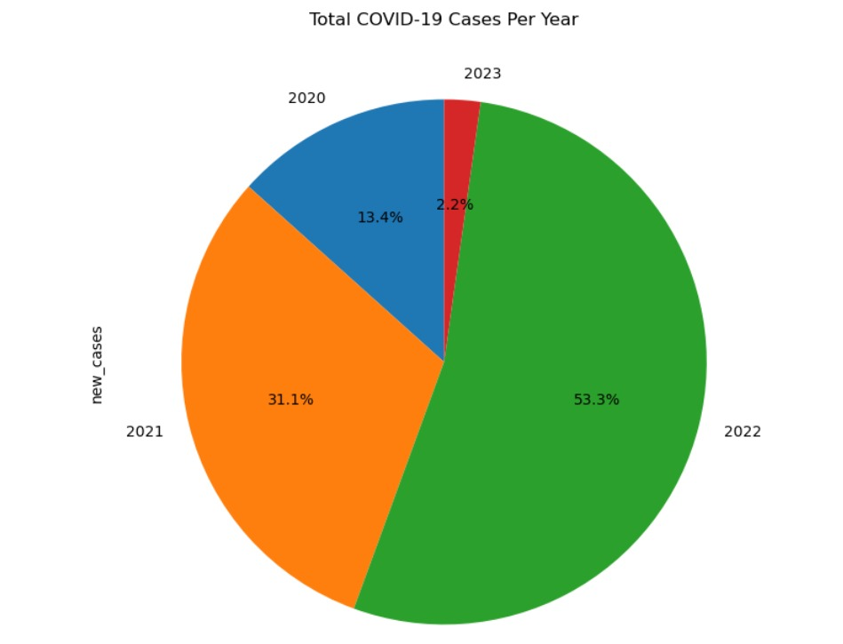
Total Covid Cases Last Four Years
Ahmed 211392

Slide 3
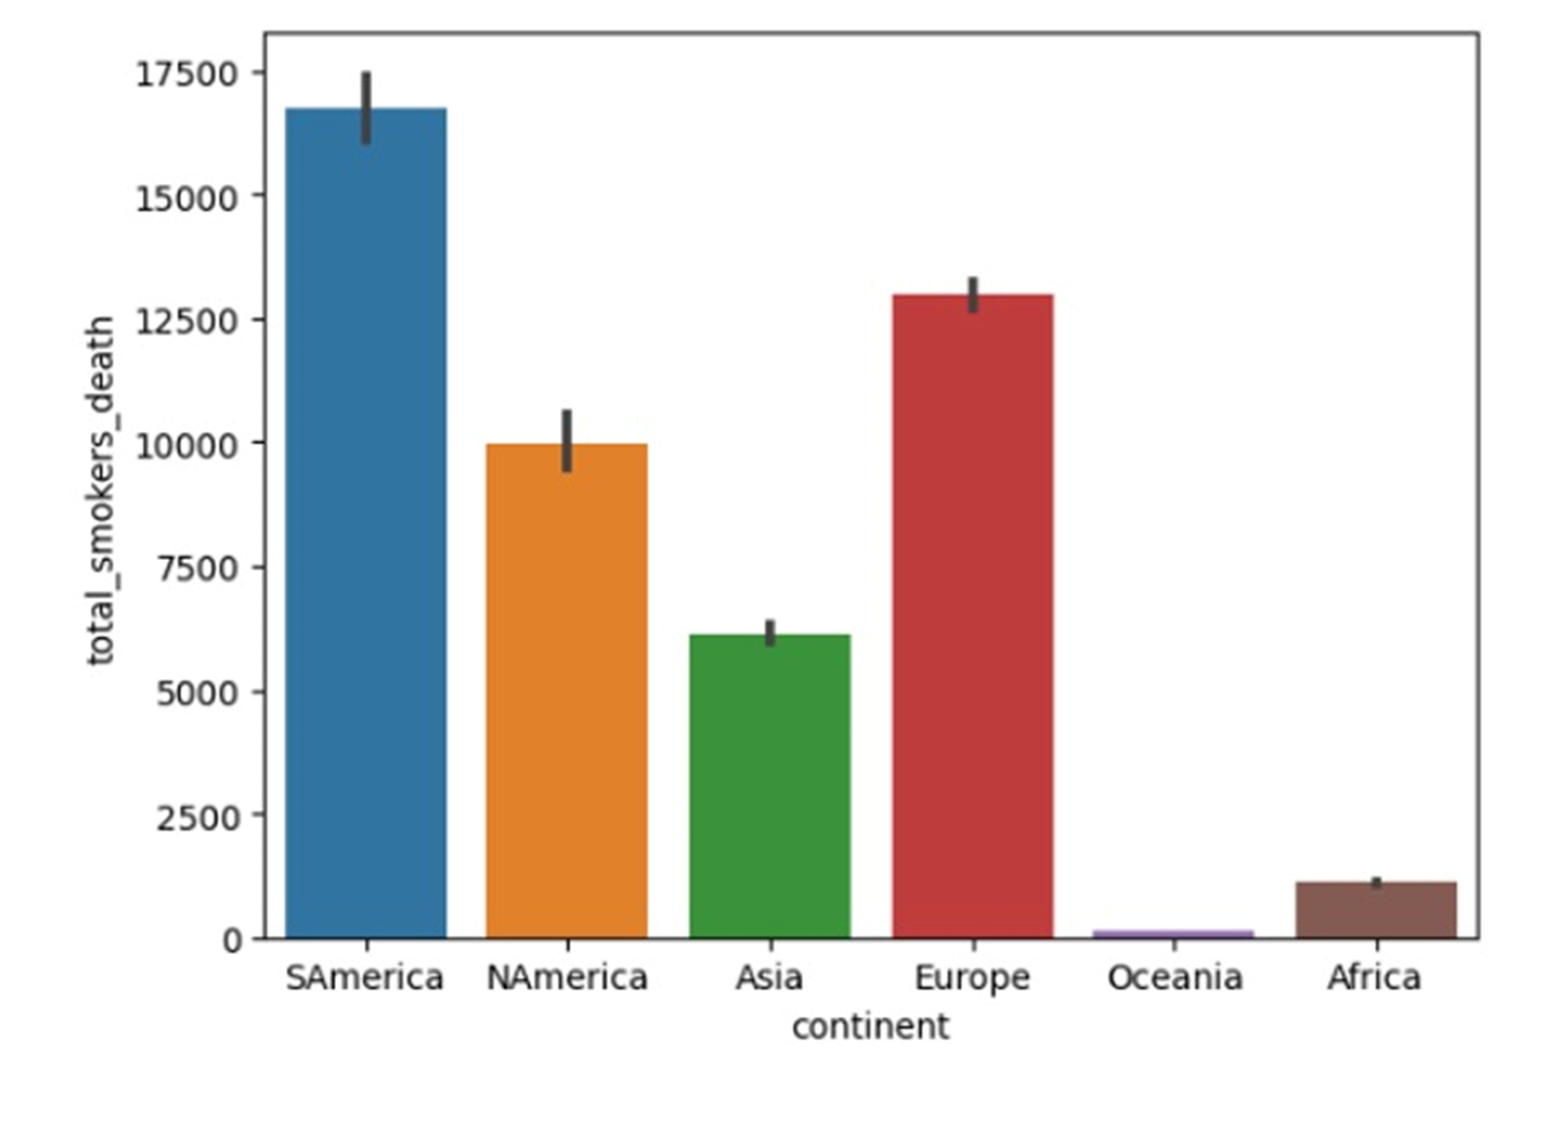
Number of deaths of smokers per continent
Ahmed 211392

Slide 4
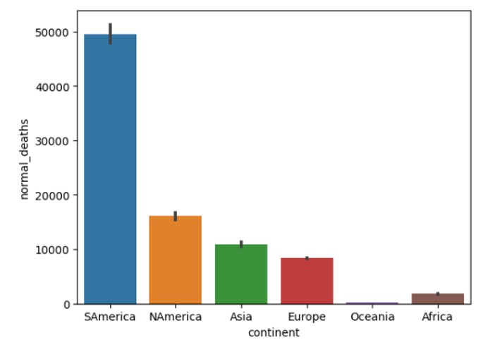
Number of deaths of non-smokers per continent
Ahmed 211392

Slide 5
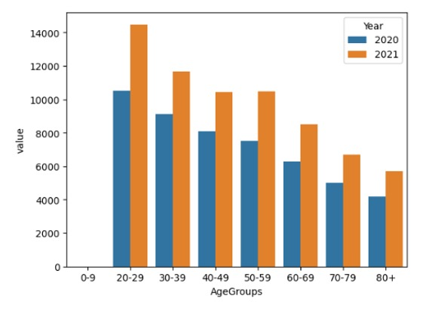
The Change of the Depression Rate of Each Age group during to Corona
Ahmed 211392

Slide 6
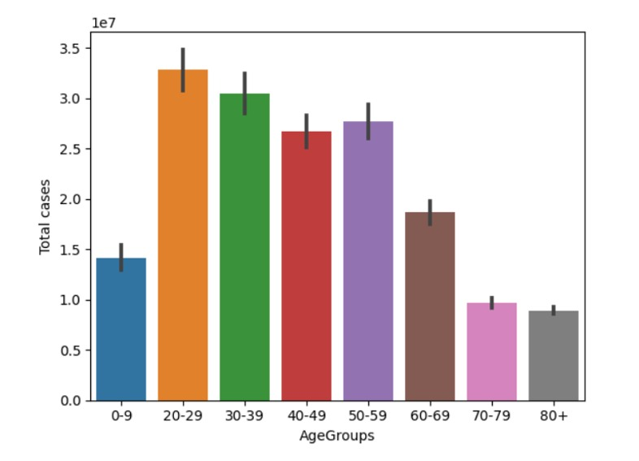
Number of Covid Cases based on each Age-group
Sara 212071

Slide 7
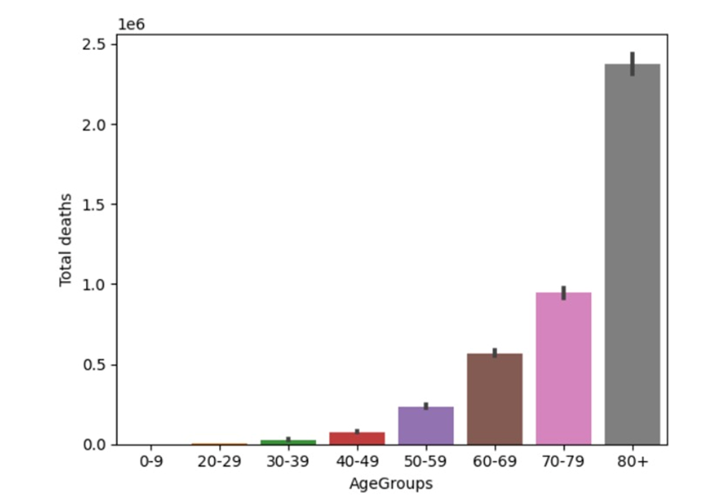
Number of Death Cases based on each Age-group
Sara 212071

Slide 8
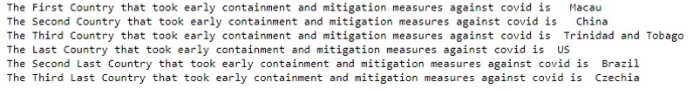
Early Precautions and COVID-19 Cases: A Comparative Analysis of Countries (Part1)
Sara 212071
Abdulrahman211896

Slide 9
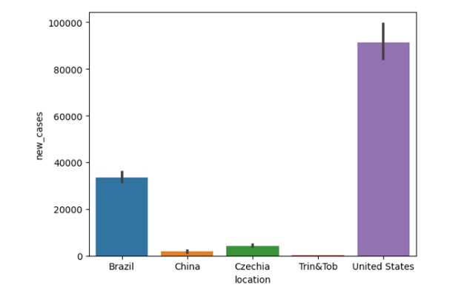
Early Precautions and COVID-19 Cases: A Comparative Analysis of Countries (Part2)
Sara 212071
Abdulrahman 211896

Slide 10
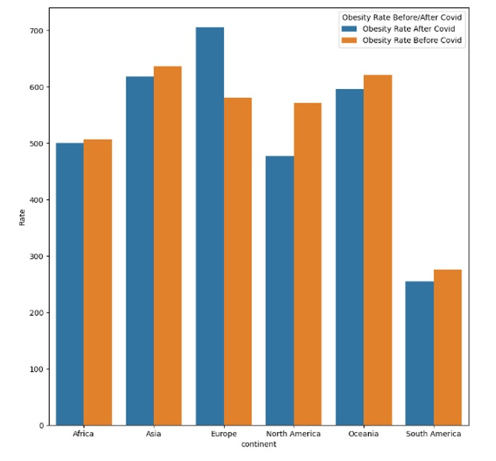
The Comparison of the Obesity Rate Before and After Corona
Sara 212071

Slide 11
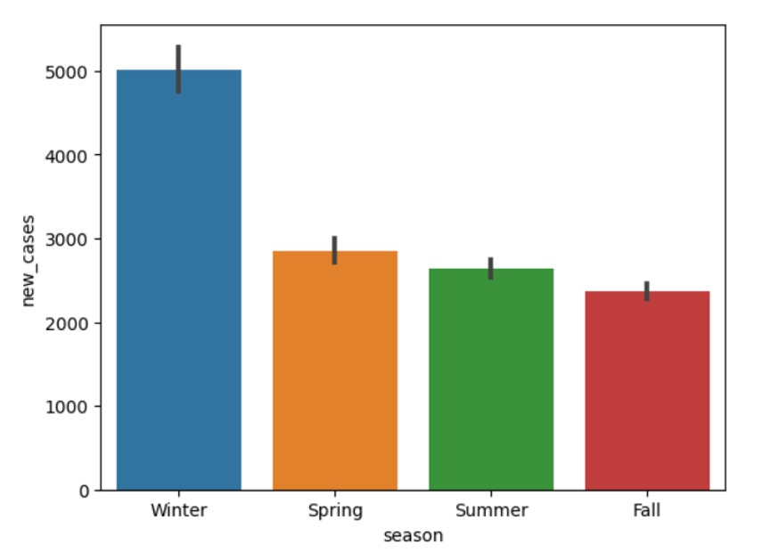
Cases Per Season
Abdulrahman211896

Slide 12
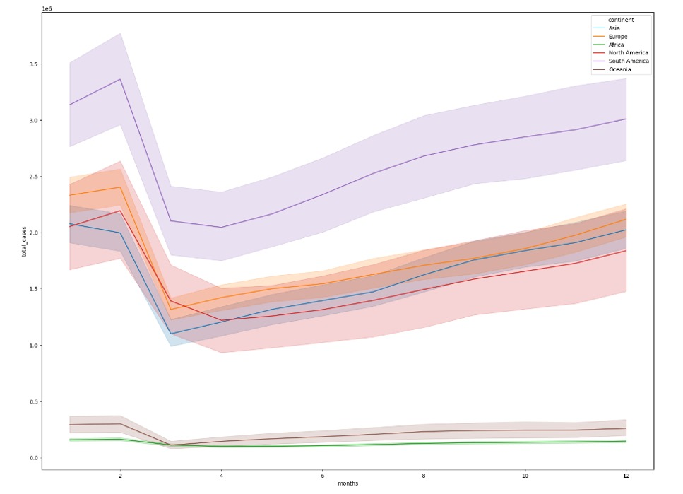
The change in total cases rate per continents during the months
Abdulrahman211896

Slide 13
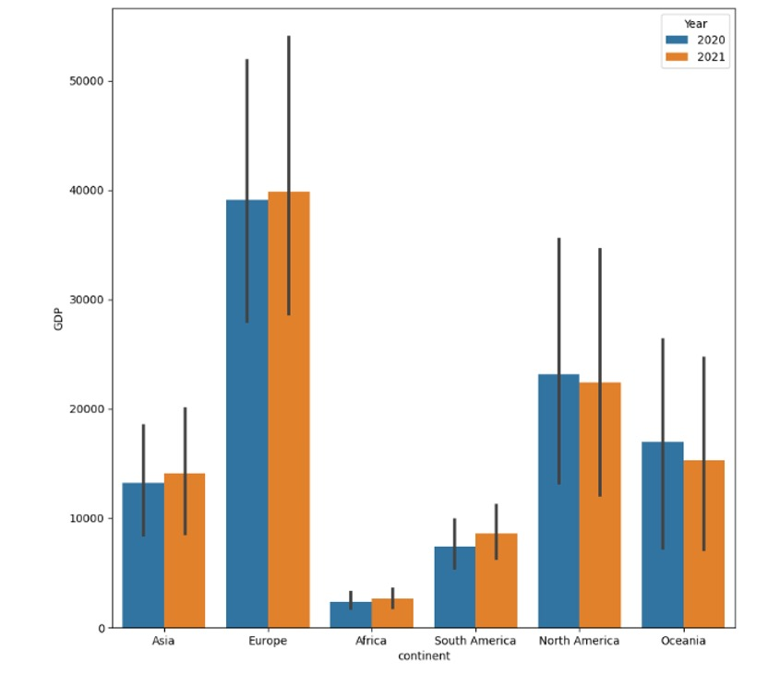
The corona affect on the GDP of each continent
Abdulrahman211896

Slide 14
The First Reported Case
Ezz 206879

Slide 15
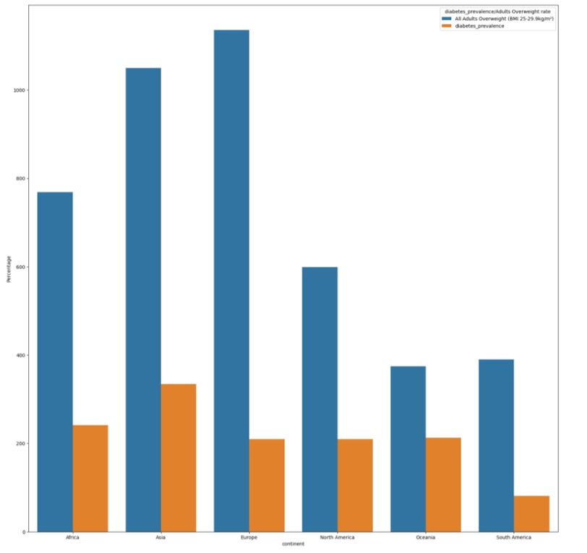
The Relationship between Overweight Rates and Diabetes Rates Across Continents
Sara 212071
Ezz 206879

Slide 16
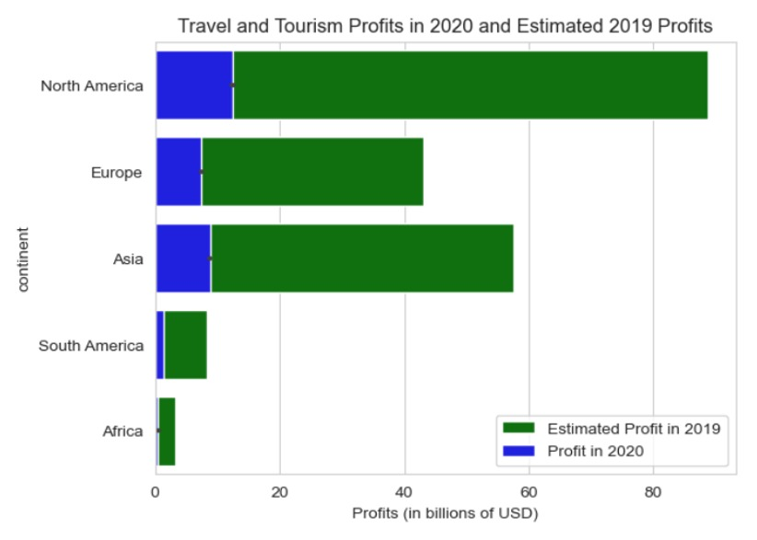
The impact of the Corona on travel and tourism profits (Part1)
Ezz 206879

Slide 17
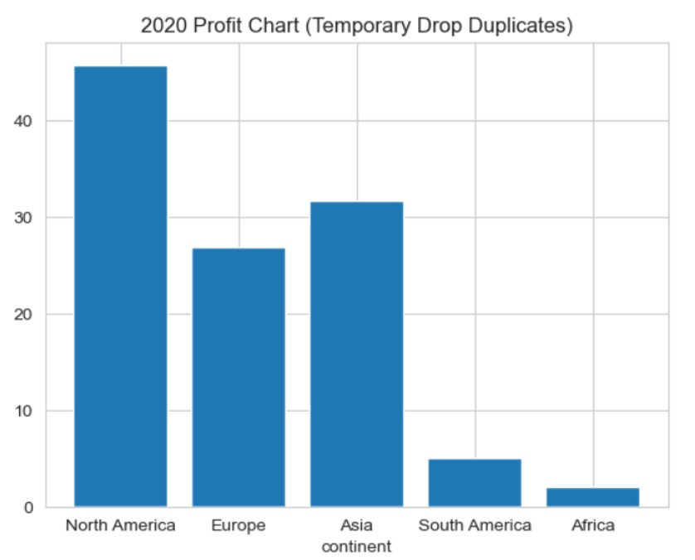
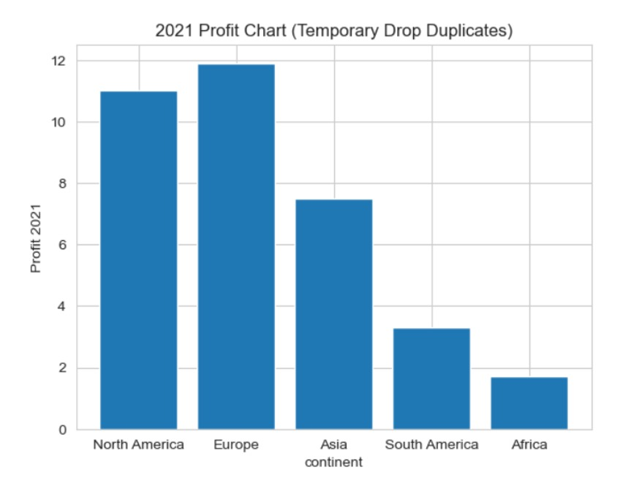
The impact of the Corona on travel and tourism profits (Part2)
Ezz 206879

Slide 18
Thank you !!

